Slide 1
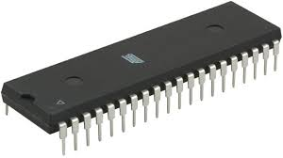
8051 MICROCONTROLLER & IT’S WORKING
By : Md Shakil Ansari

Slide 2
CONTENTS
Introduction
Difference Between Microprocessors & Microcontroller
Types of Microcontrollers
Pin Diagram and details of 8051
Architecture of 8051
Interrupts of 8051
Application

Slide 3
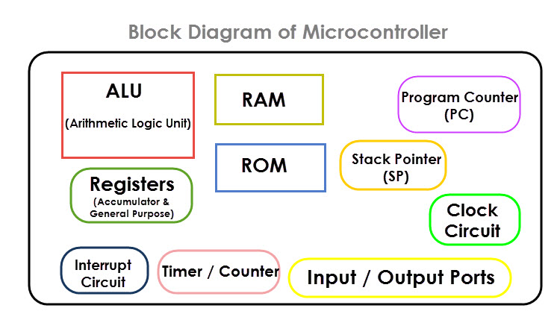
INTRODUCTION
A Microcontroller is a VLSI IC that contains a CPU (Processor) along with some other peripherals like Memory (RAM and ROM), I/O Ports, Timers/Counters, Communication Interface, ADC etc
The 8051 Microcontroller is one of the most popular and most commonly used microcontrollers in various fields like embedded systems, consumer electronics, automobiles, etc.

Slide 4
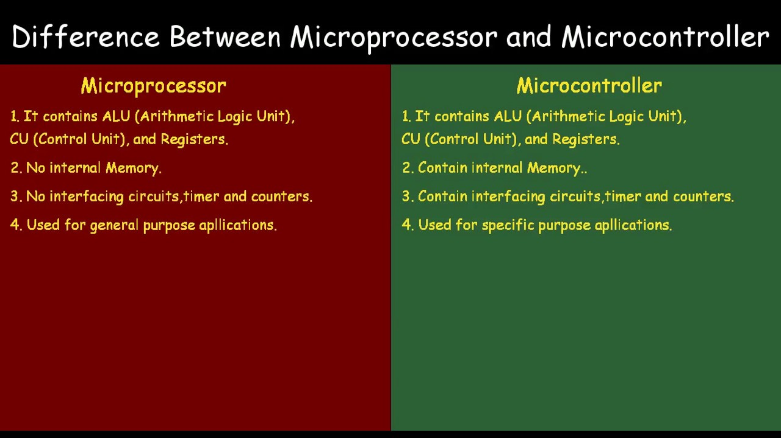
Difference Between Microprocessors & Microcontroller

Slide 5
Types of Microcontroller
Microcontrollers are characterized by their bits, memory architecture, memory/devices and instruction set. Let’s discuss briefly about it.
Depending upon BUS width( data size):
8 Bit : The internal bus size of these microcontroller is 8-bit.The examples of 8-bit microcontrollers are Intel 8031/8051, PIC1x and Motorola MC68HC11 families.
16 Bit : Some examples of 16-bit microcontroller are 16-bit MCUs are extended 8051XA, PIC2x, Intel 8096 and Motorola MC68HC12 families.
32 Bit : The 32-bit microcontroller uses the 32-bit instructions to perform the arithmetic and logic operations.
e.g-Intel/Atmel 251 family, PIC3x.

Slide 6
Types of Microcontroller contd..
Classification According to Instruction Set:
CISC: CISC is a Complex Instruction Set Computer.
RISC: The RISC is stands for Reduced Instruction set Computer, this type of instruction sets reduces the design of microprocessor for industry standards.
Note: The RISC gives a better execution than the CISC.
Depending on Memory Architecture :
Harvard Memory Architecture Microcontroller: When a microcontroller unit has a dissimilar memory address space for the program and data memory.
Princeton Memory Architecture Microcontroller: When a microcontroller has a common memory address for the program memory and data memory.

Slide 7
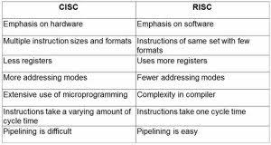
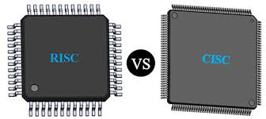
Types of Microcontroller contd..

Slide 8
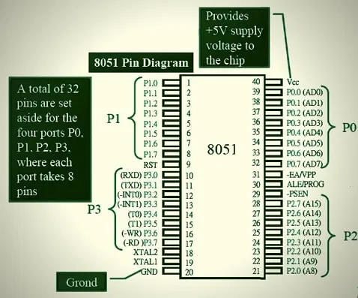
Pin Diagram & Details

Slide 9
Pin Diagram & Details
Pin-40: Vcc Pin 20: Vss –ground. Pins 32-39: Known as Port 0 (P0.0 to P0.7) to serving as I/O ports. Pin-31: Address Latch Enable (ALE) Pin-30: (EA) External Access input is used to enable or disable external memory interfacing. Pin- 29: Program Store Enable (PSEN) is used to read signal from external program memory. Pins- 21-28: Known as Port 2 (P 2.0 to P 2.7) – quasi bidirectional port. Pins 18 and 19: Used to interfacing an external crystal to provide system clock. Pins 10 – 17: This port also serves some other functions like interrupts, timer input, control signals for external memory interfacing Read and Write. Pin 9: It is a RESET pin Pins 1 – 8: This port does not serve any other functions. Port 1 is a quasi bi directional I/O port.

Slide 10
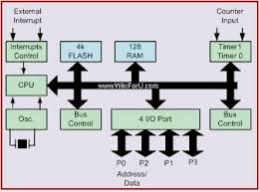
Architecture of 8051
The 8051 microcontroller is based on harvard architecture.

Slide 11
Interrupts of 8051
The 8051 deals with 5 interrupts .
INT0 :external request from p3.2 pin.
TIMER 0 : Overflow from TIMER 0 activates interrupt request flag TF0.
INT1: external request from p3.3.
Timer1: Overflow from TIMER 0 activates interrupt request flag TF1.
Serial Port : completion of transmission or reception of a serial frame activates the flag T1 or RI.

Slide 12

Application
Microcontroller has many applications electronic equipment’s
Mobile Phones
Auto Mobiles
Washing Machines
Cameras
Security Alarms

Slide 13


